Slide 1
Zelda 2

Slide 2
Isabelle Leclerc
2D Artist

Slide 3
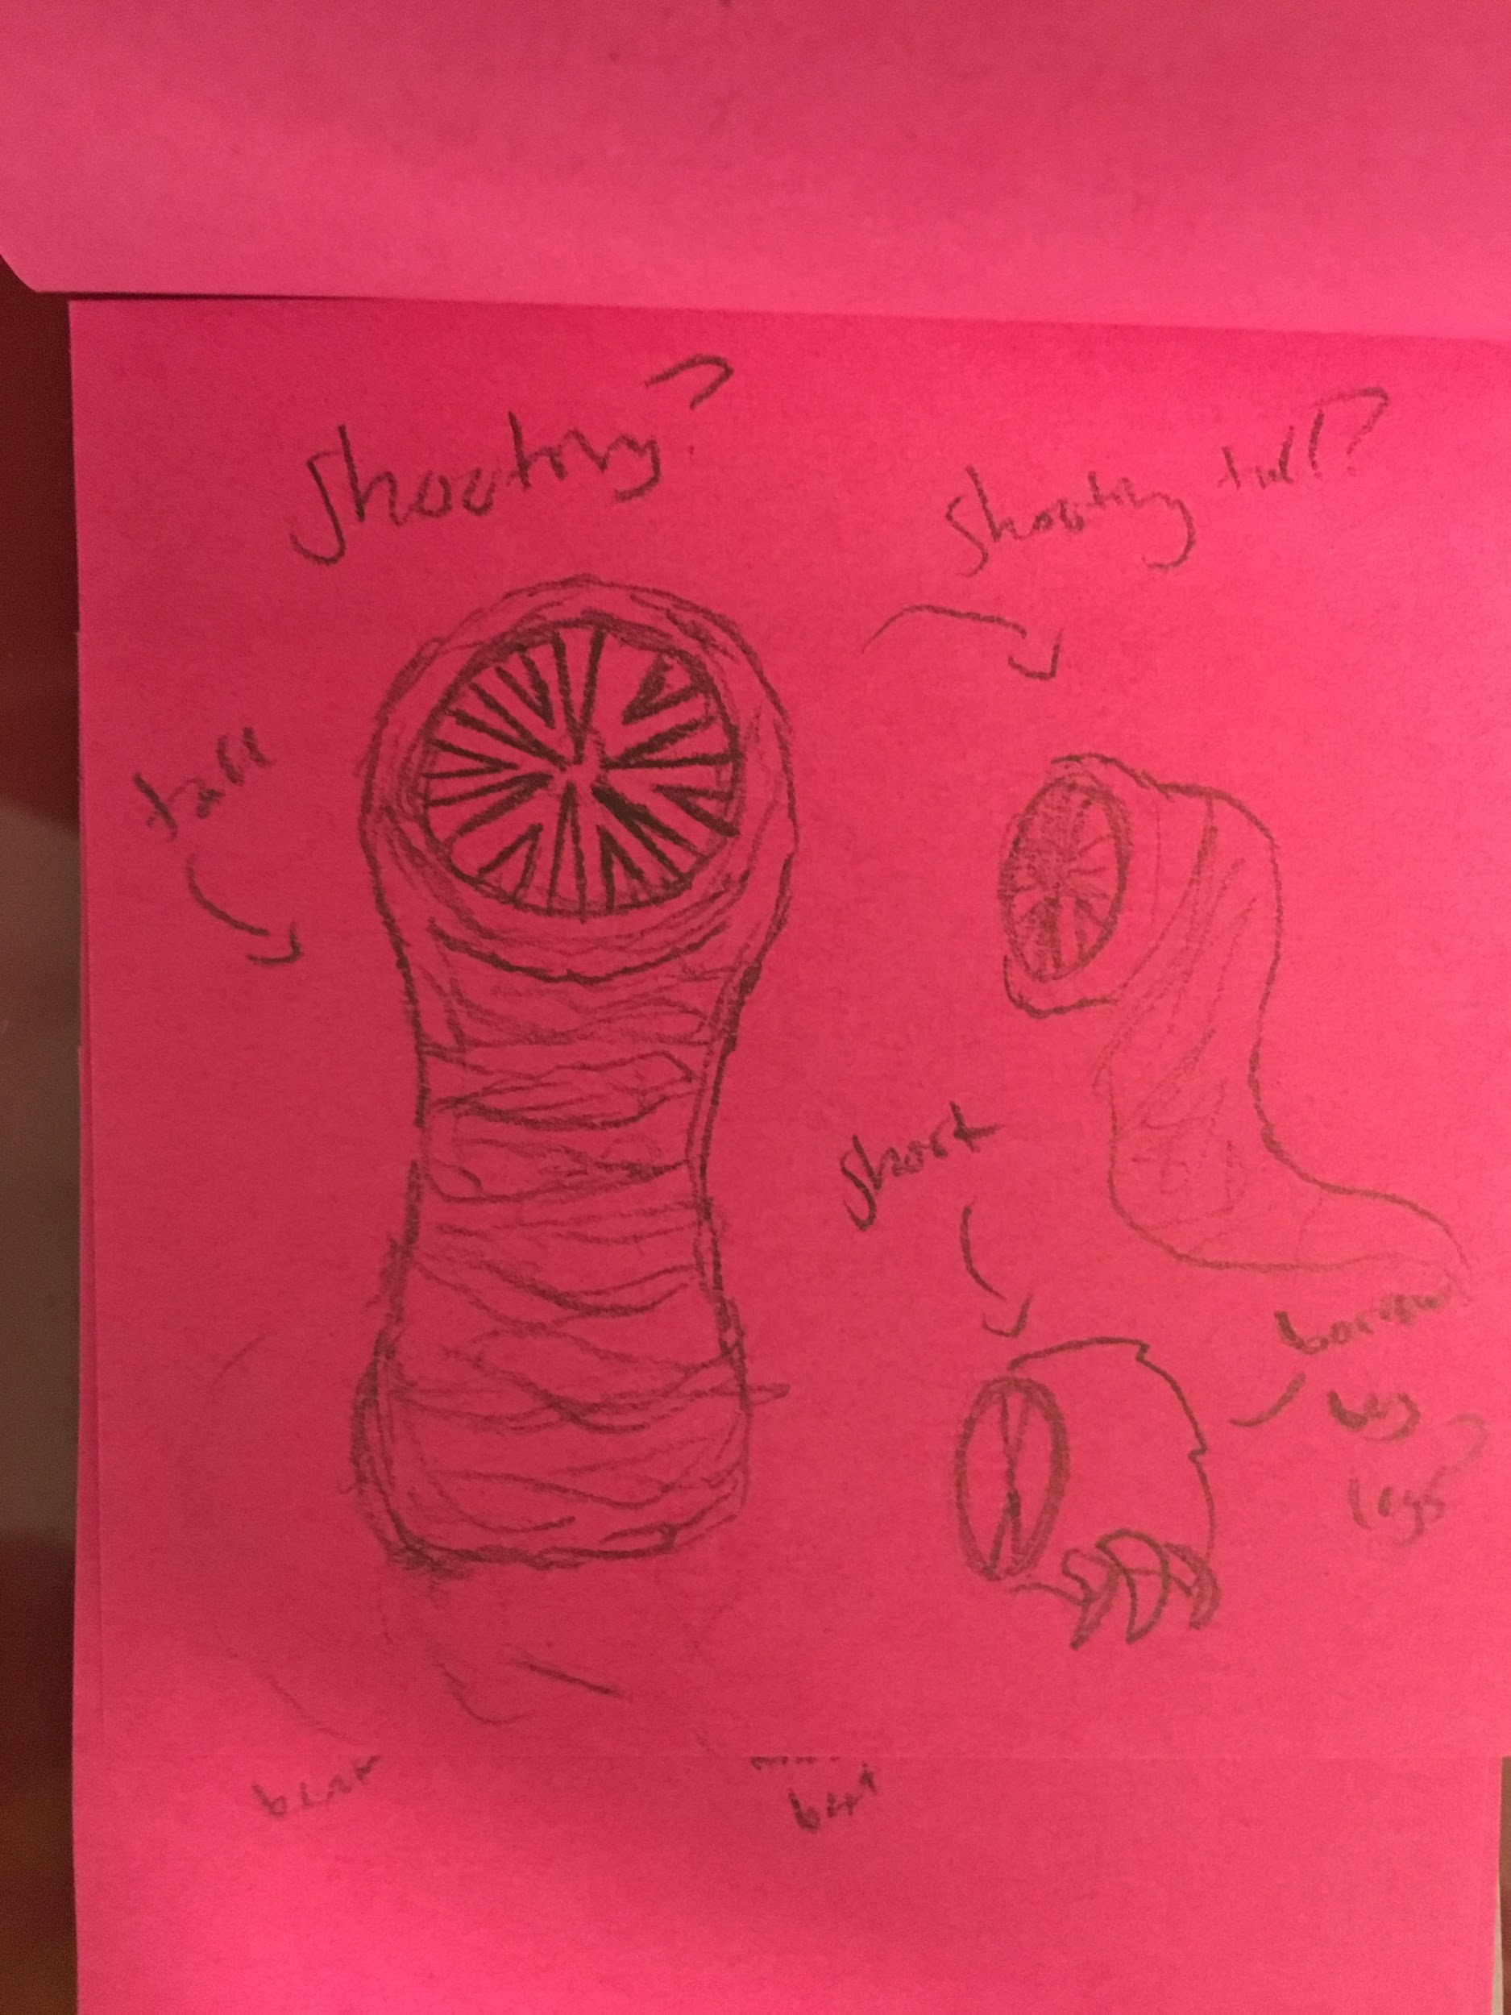
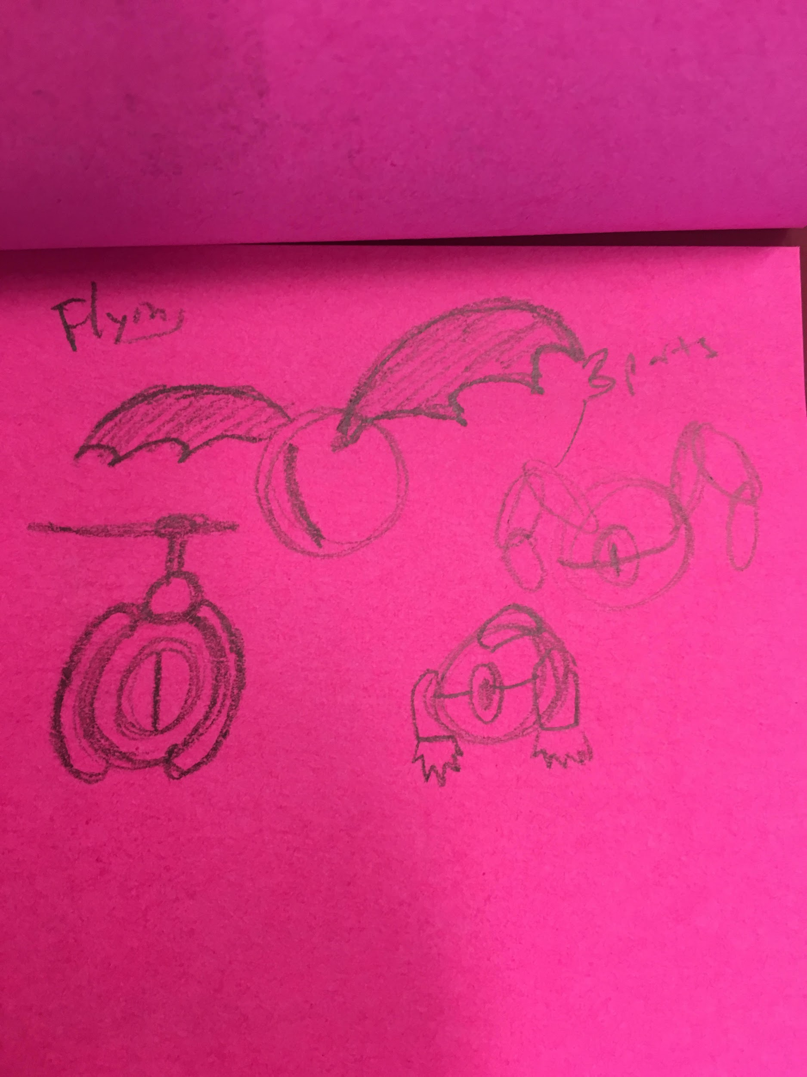
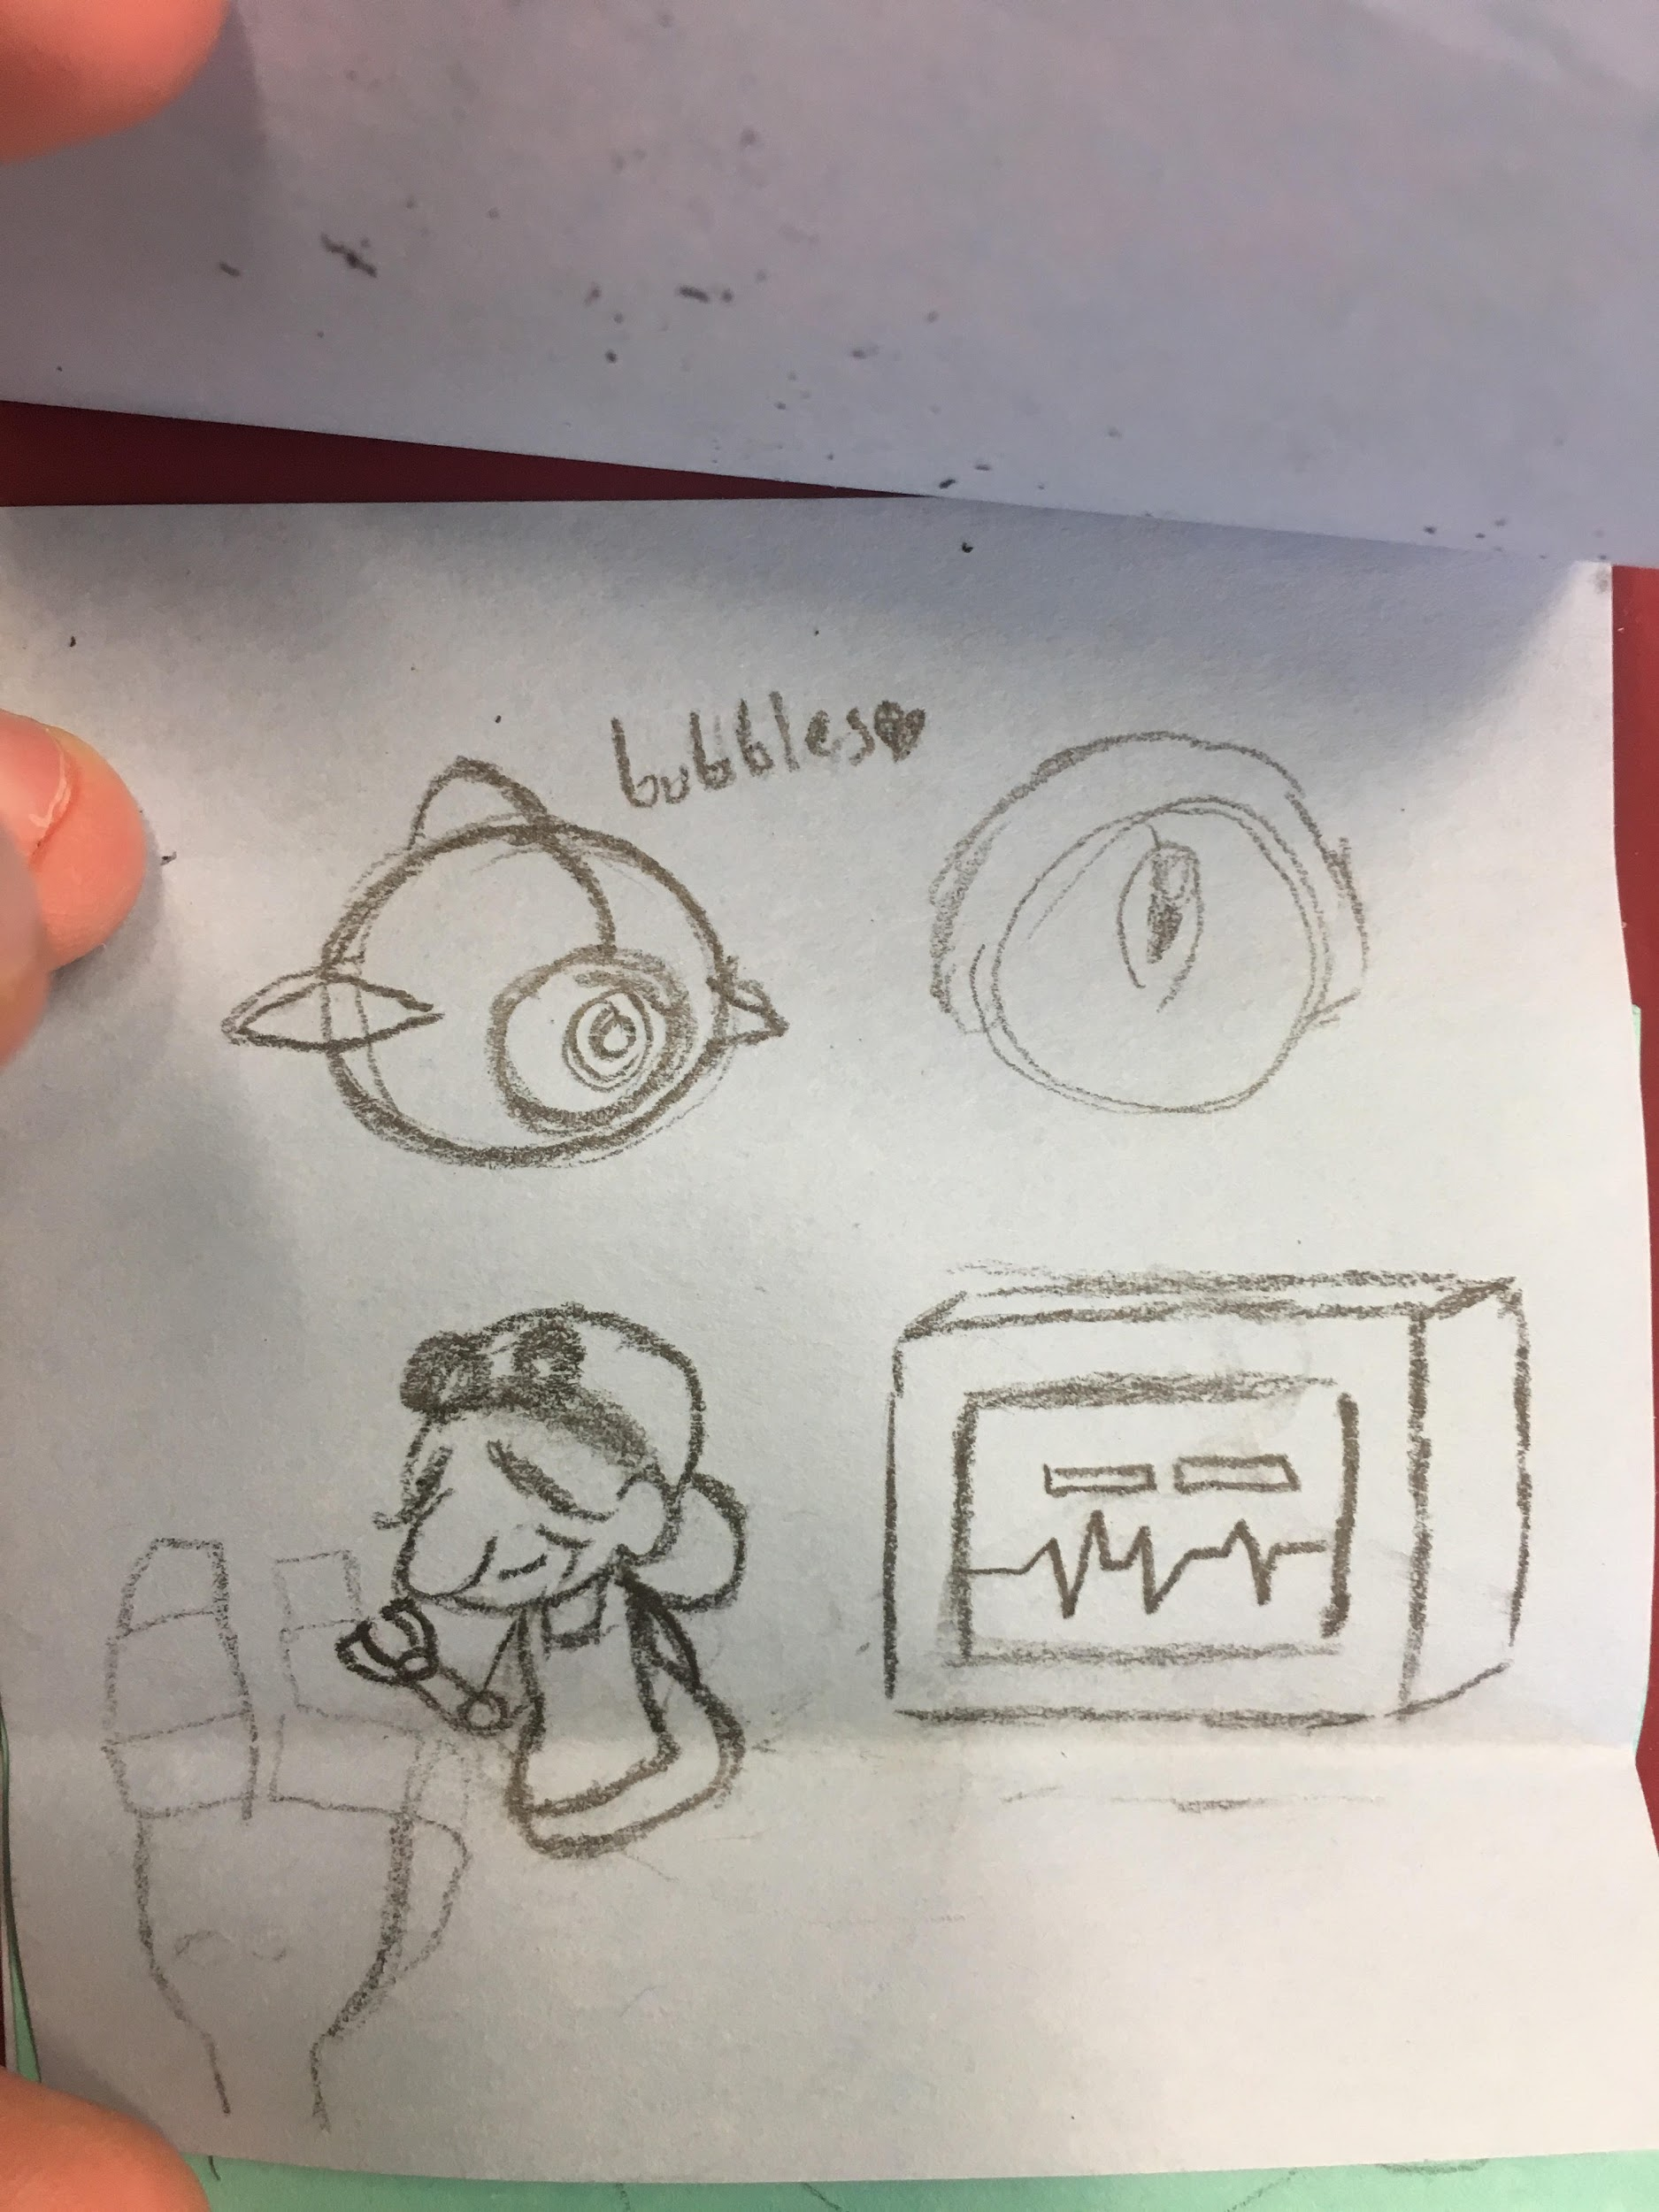
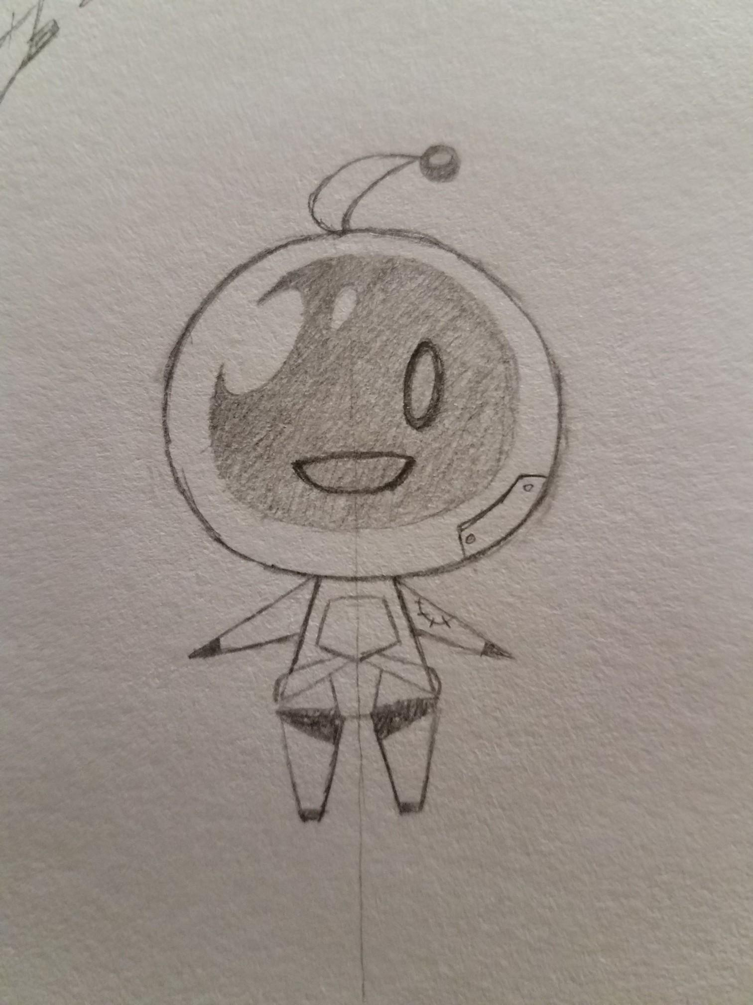

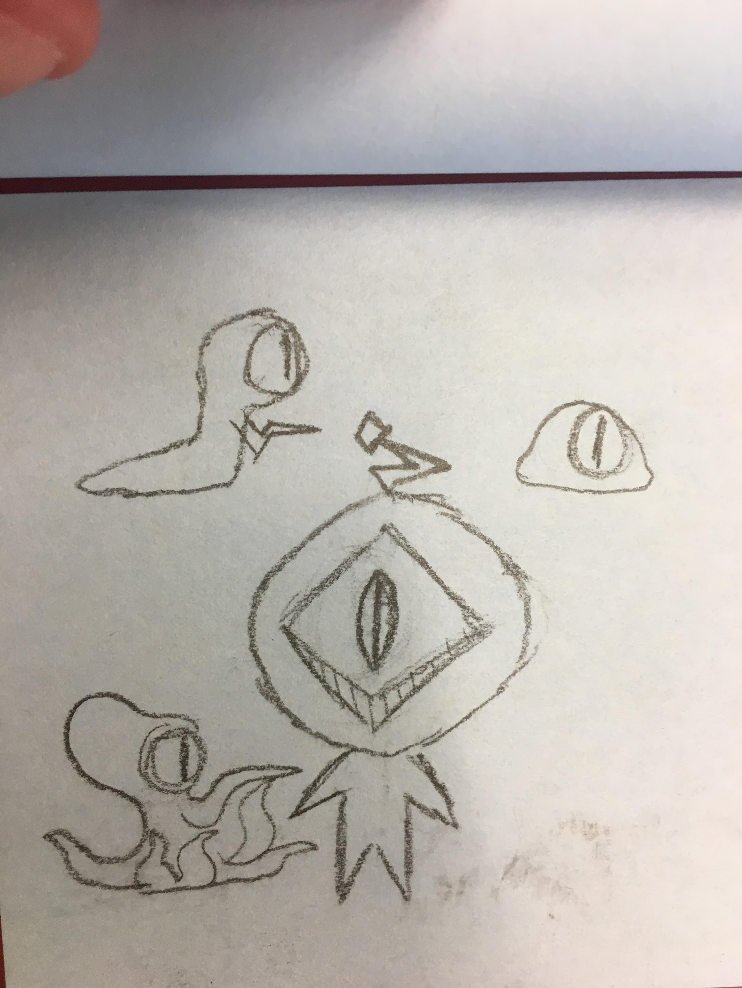
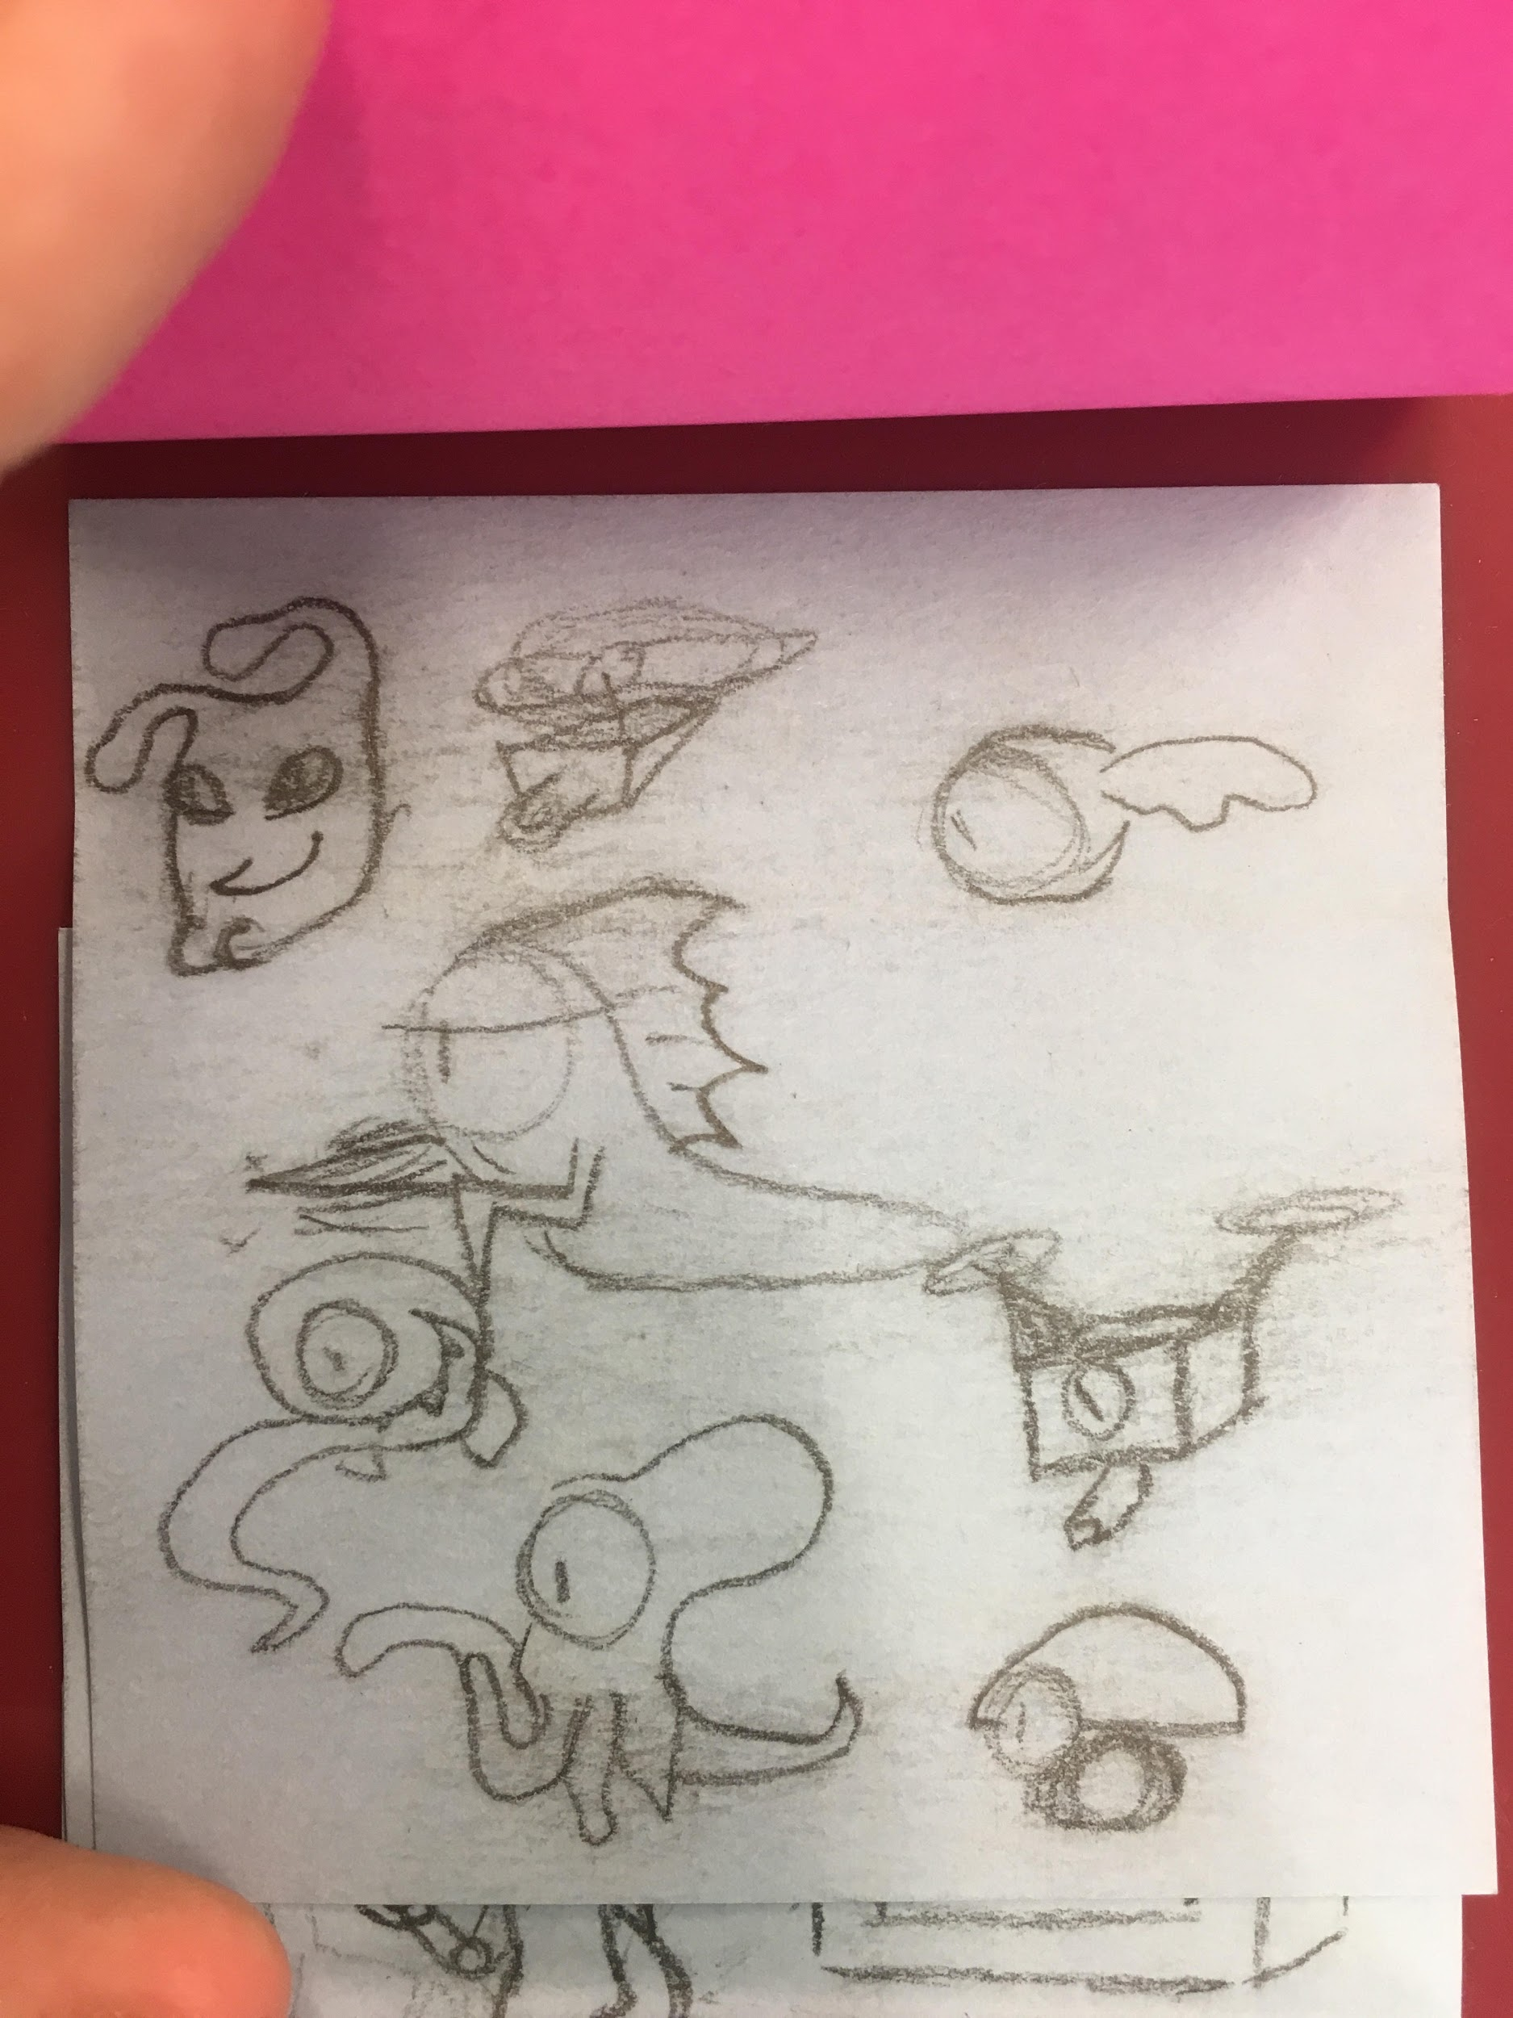
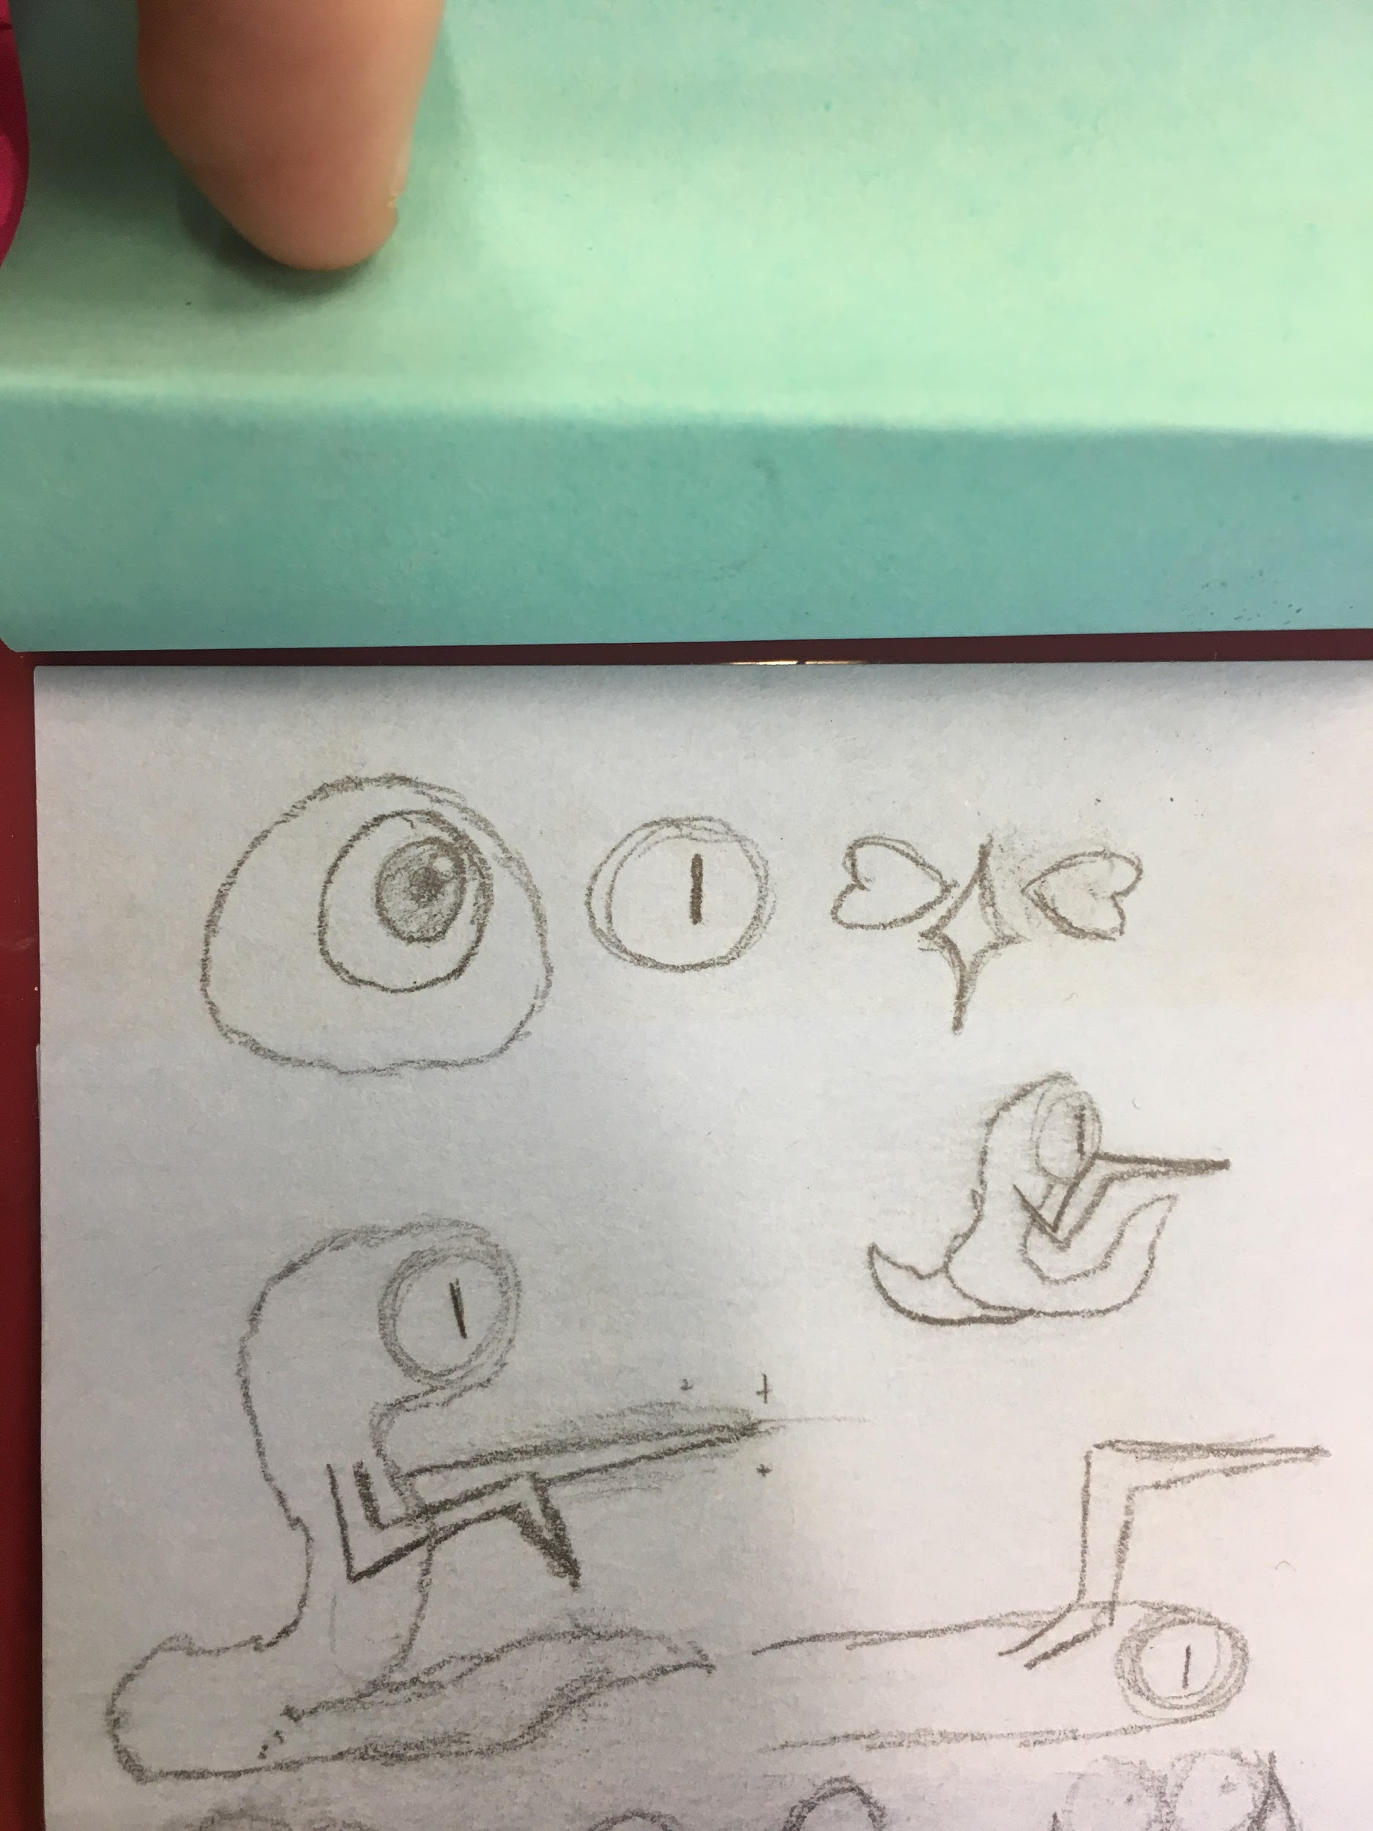
Original Character Design by Michael Einhorn
Color Scheme Approved and Created by Michael Einhorn
Character, Enemy and Prop Design and Animation Concepts

Slide 4
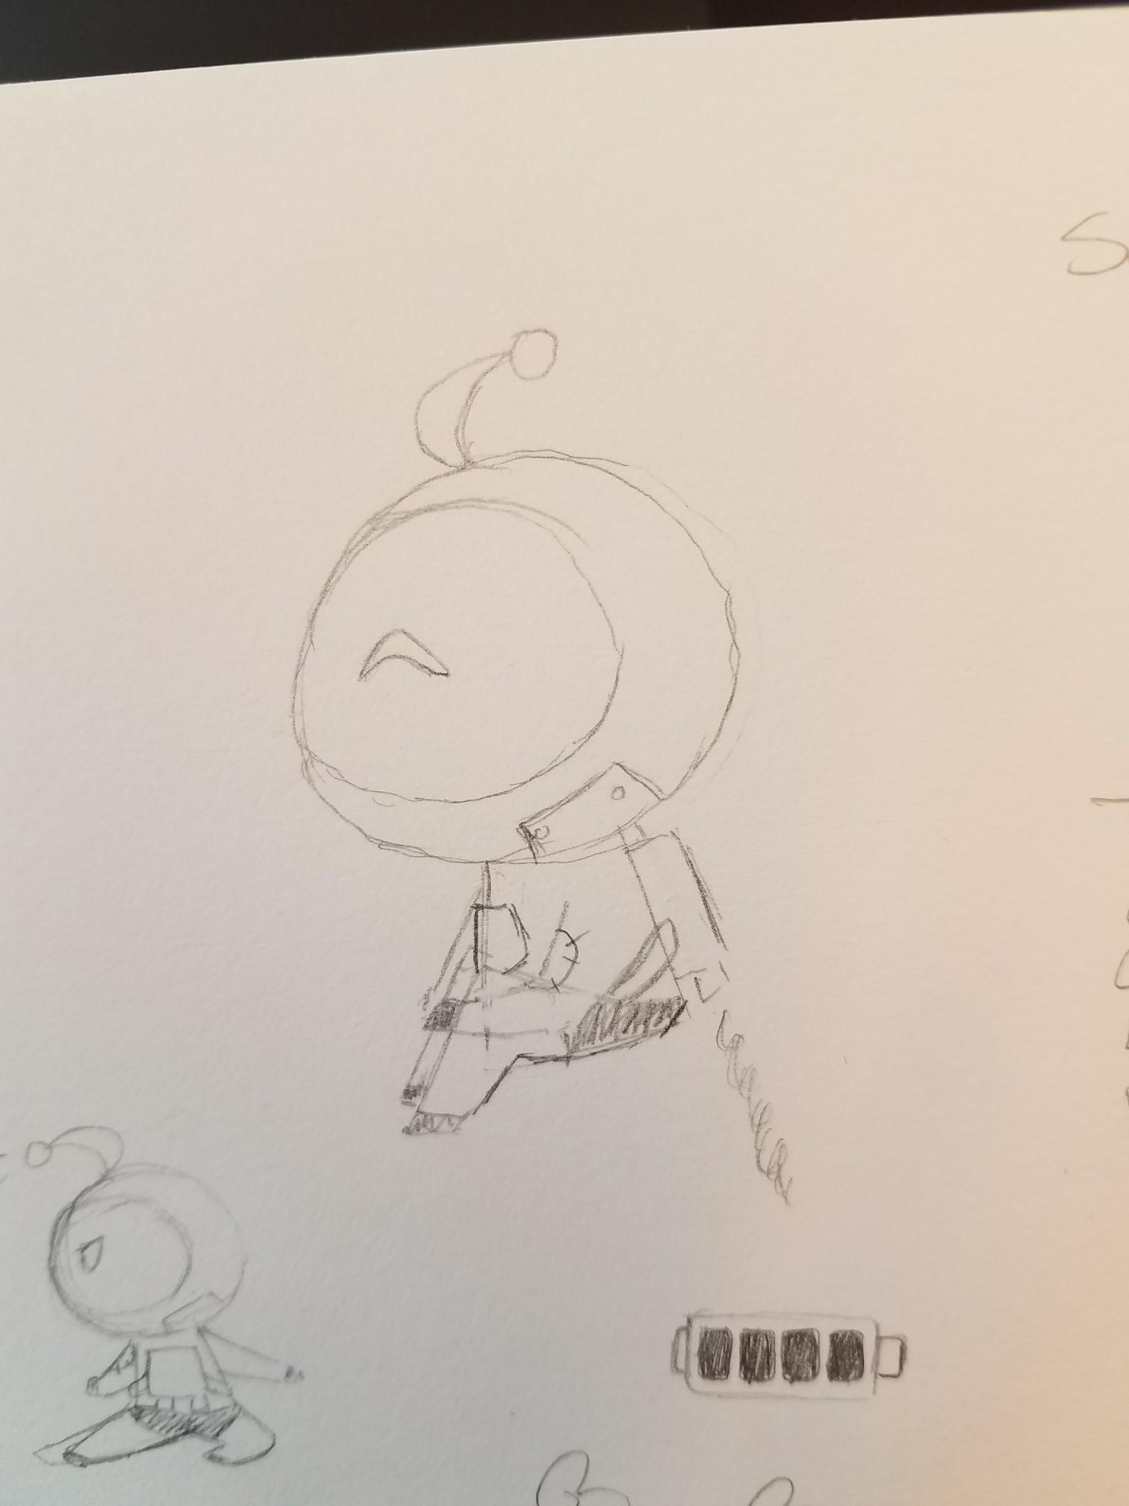
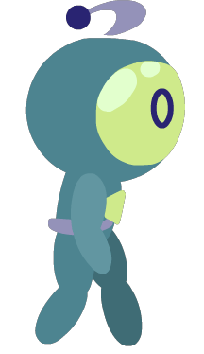



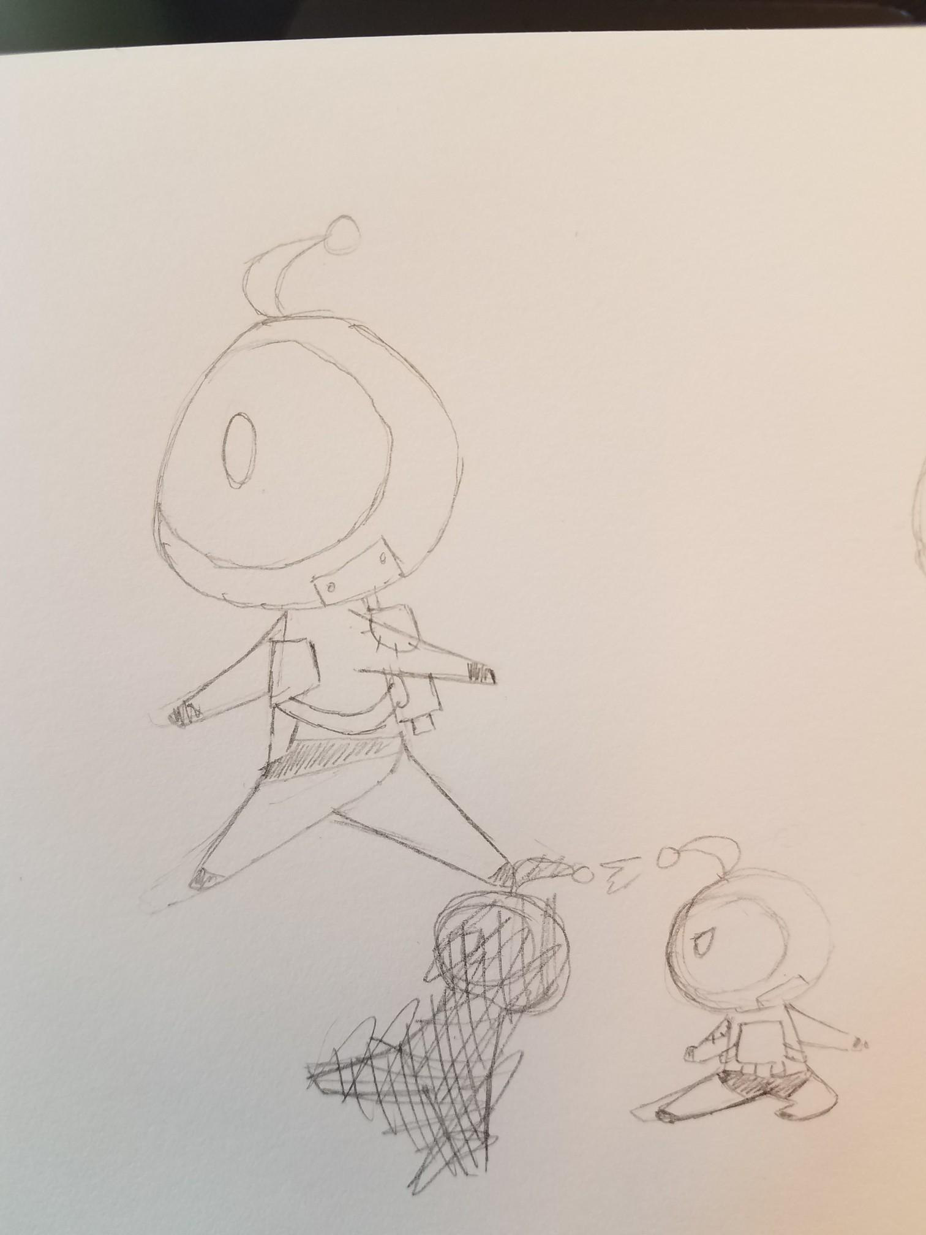

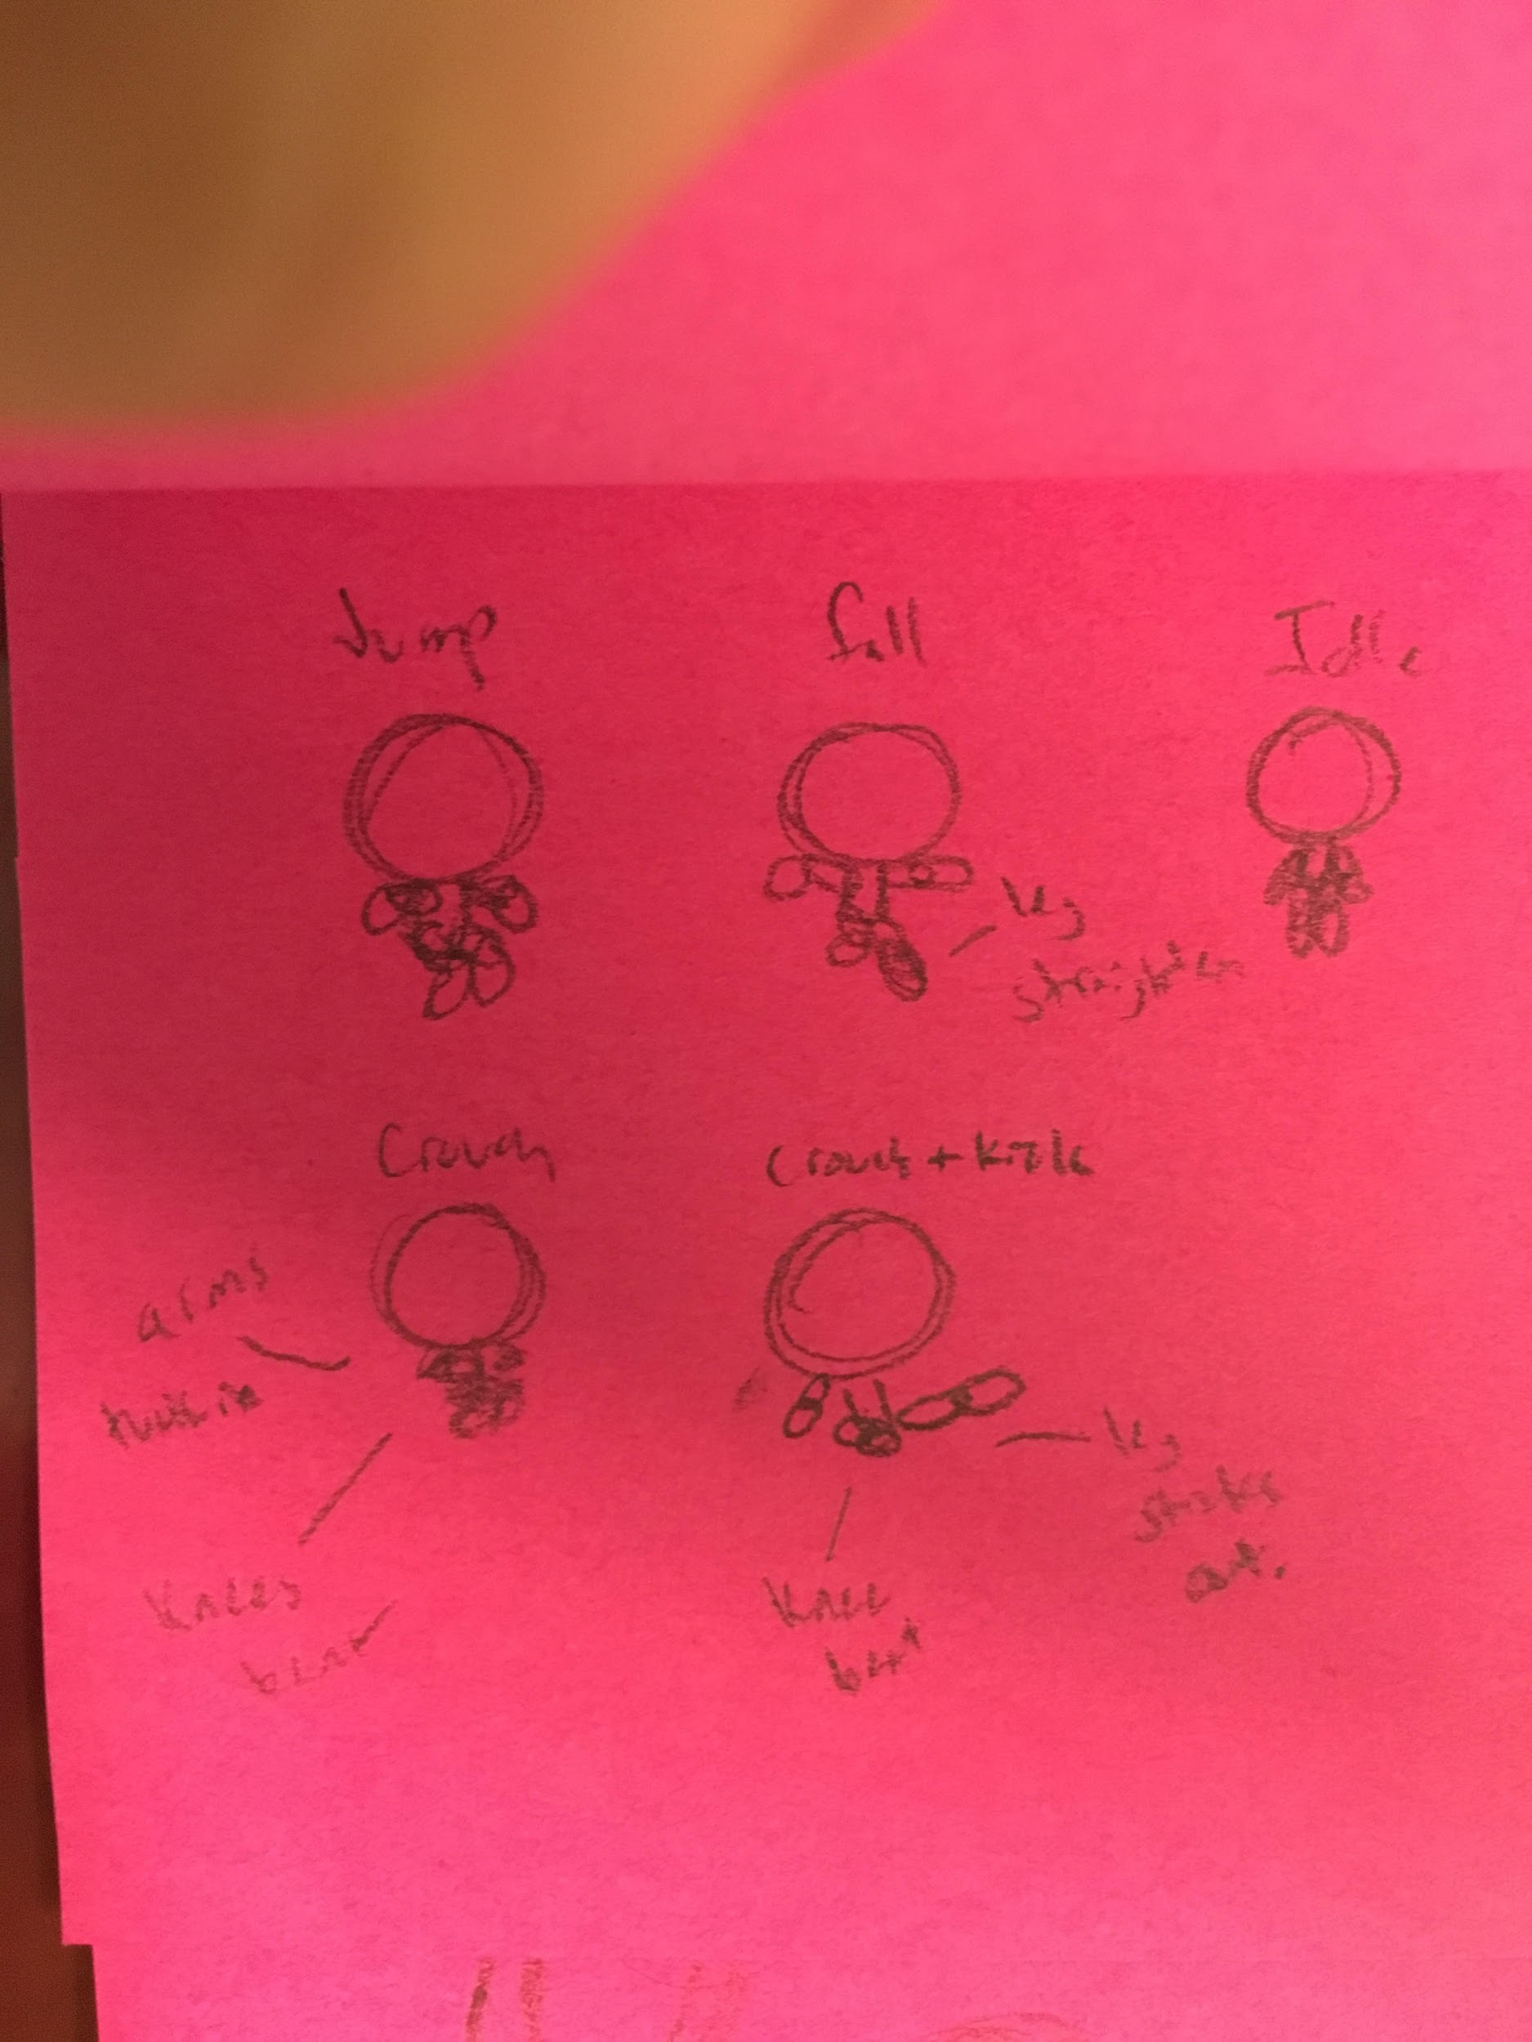

Beige concepts done by Milah Einhorn
Character Design

Slide 5



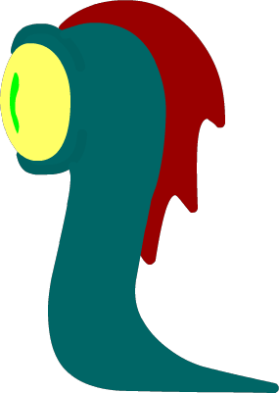


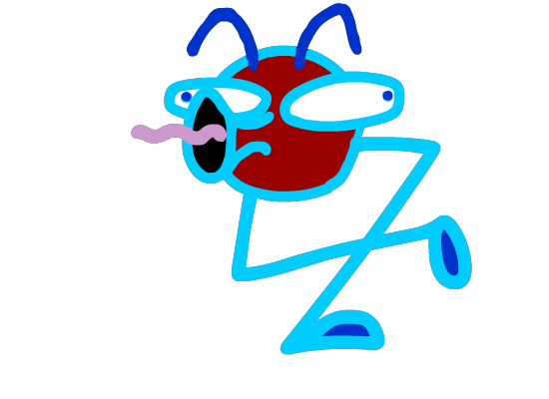


Enemy Design

Slide 6

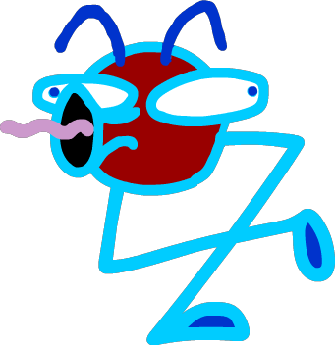




Prop + Other Design

Slide 7
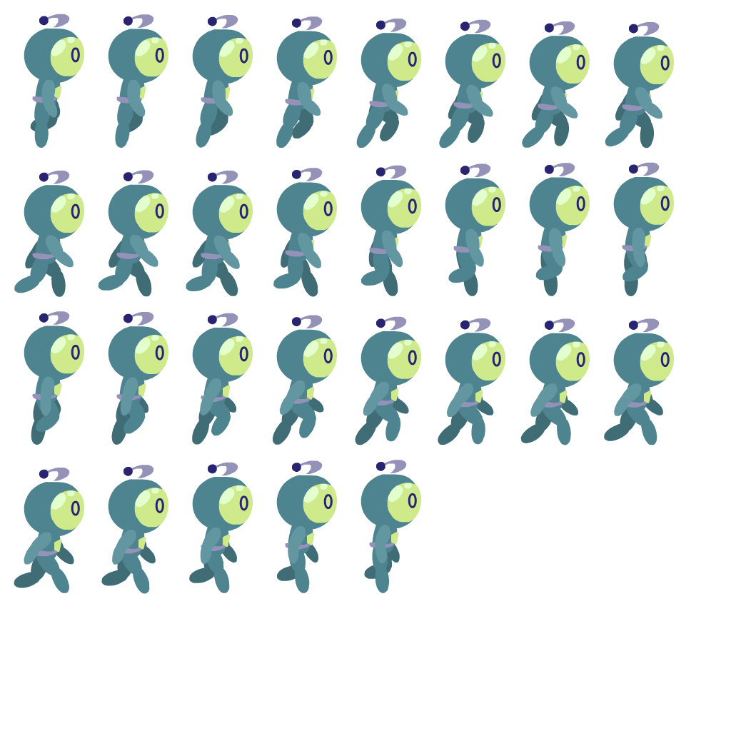
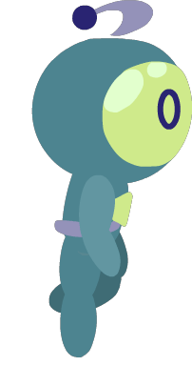
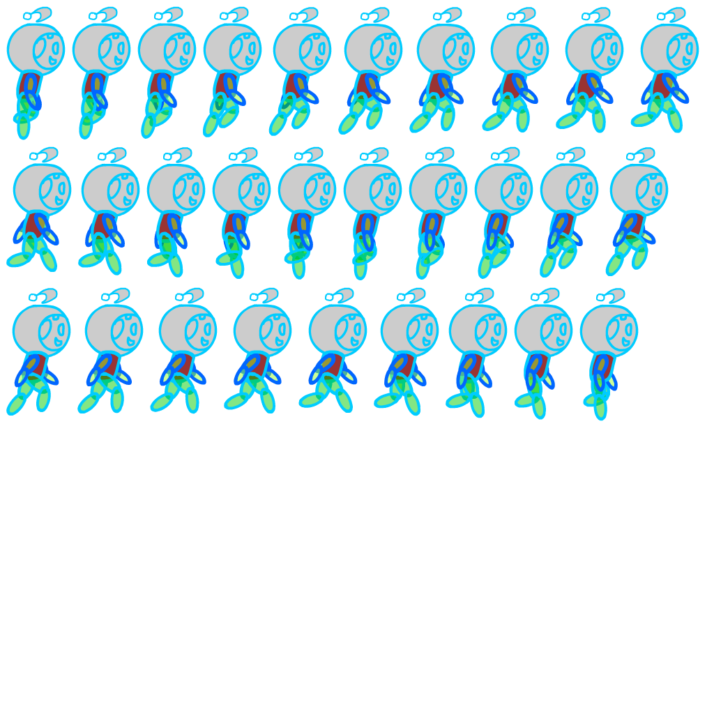
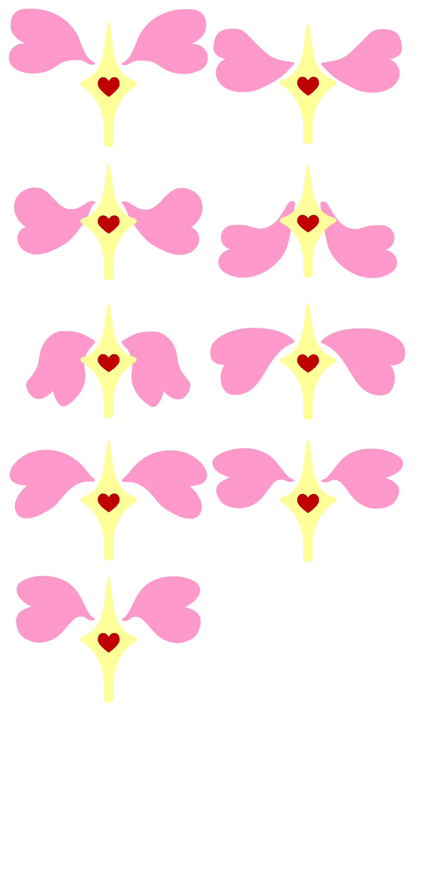
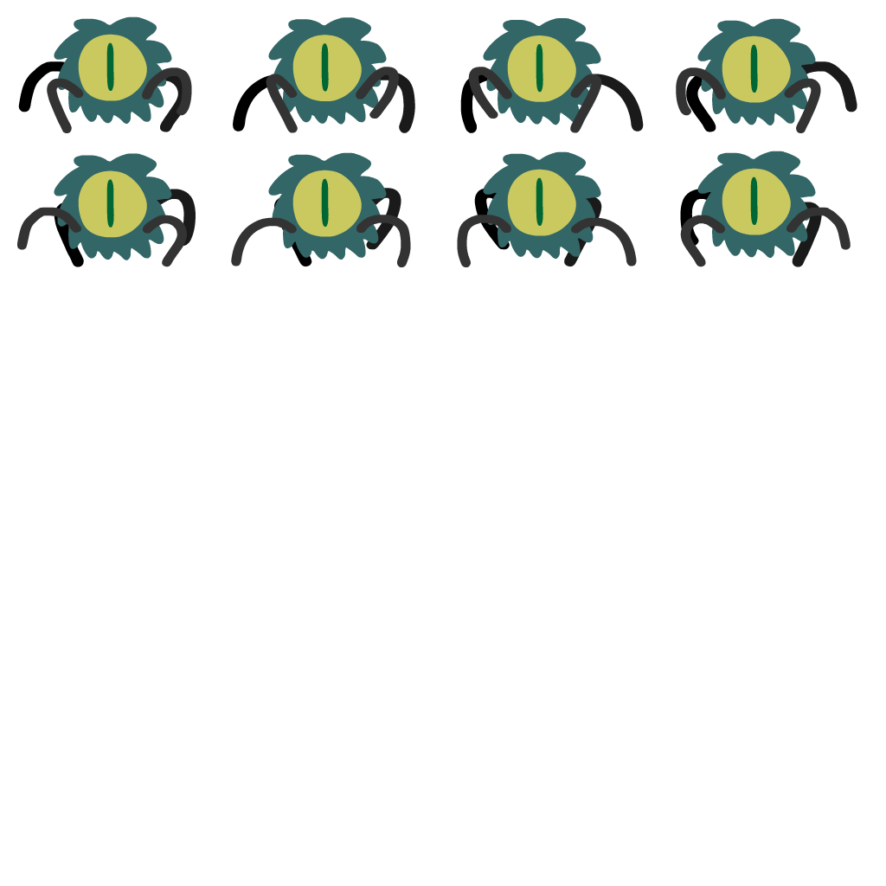
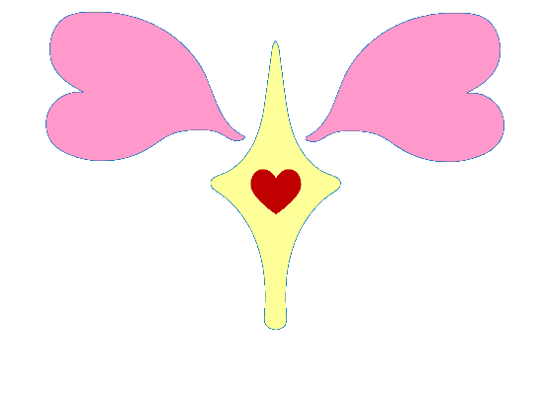

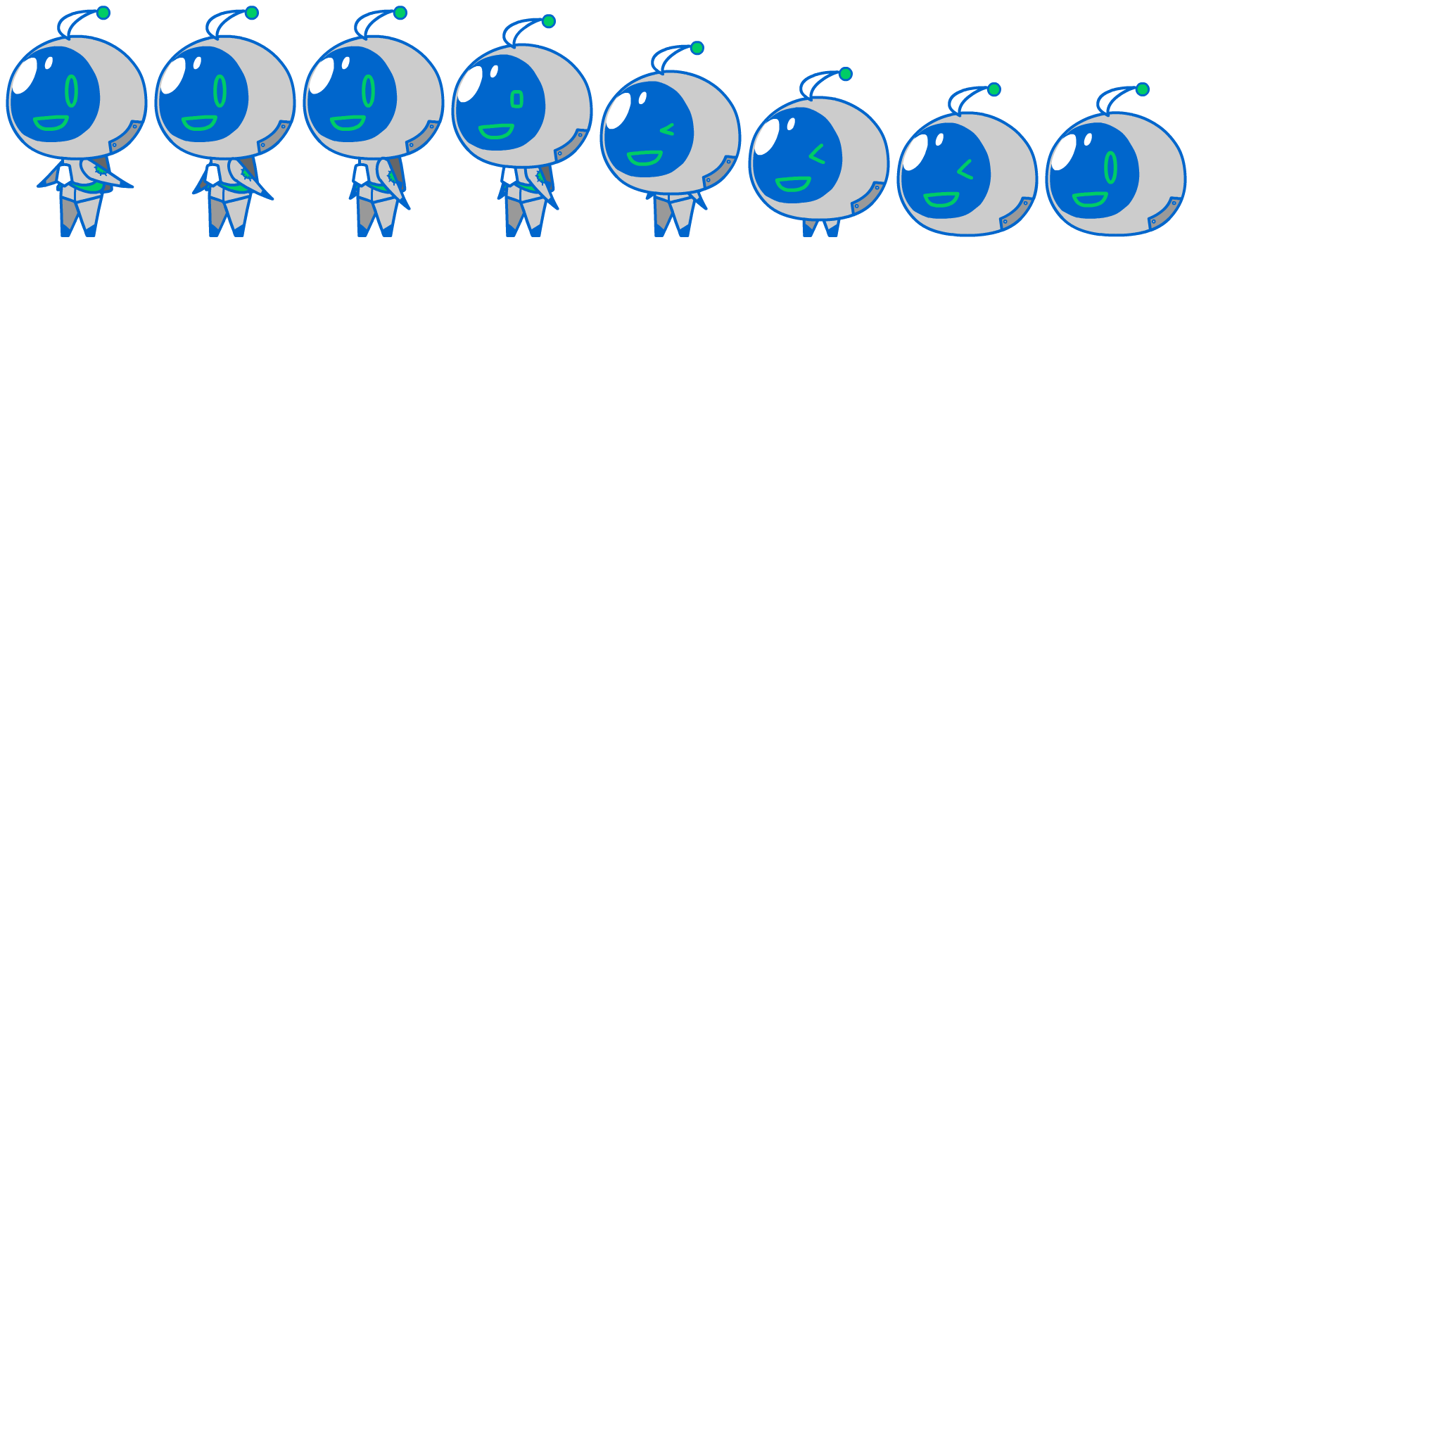
Animation and Animation Concepts

Slide 8
Milah Thomas - 2D Artist

Slide 9
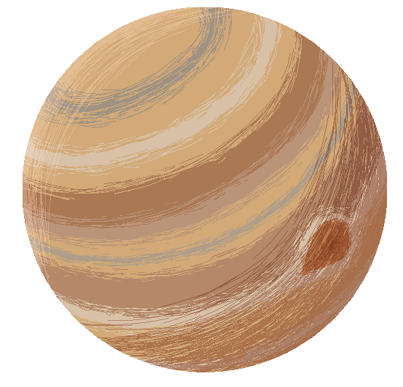
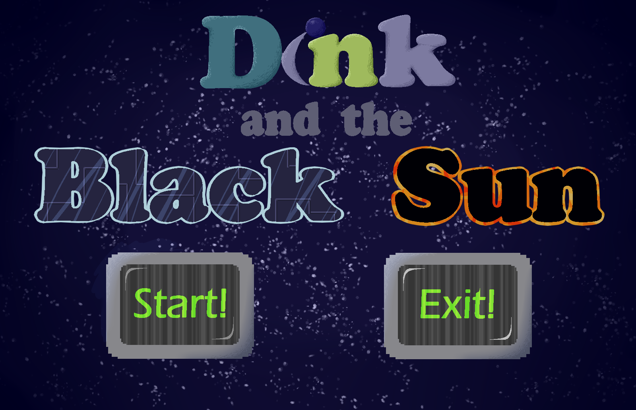
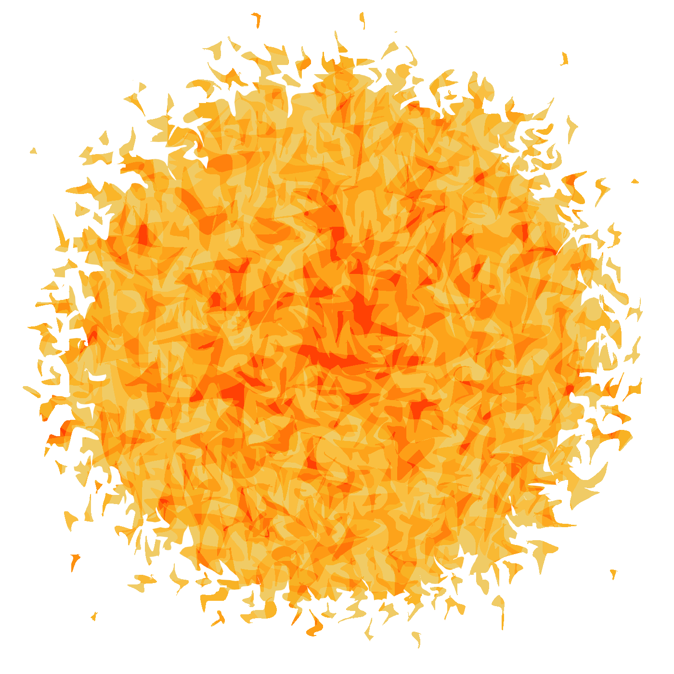

Slide 10

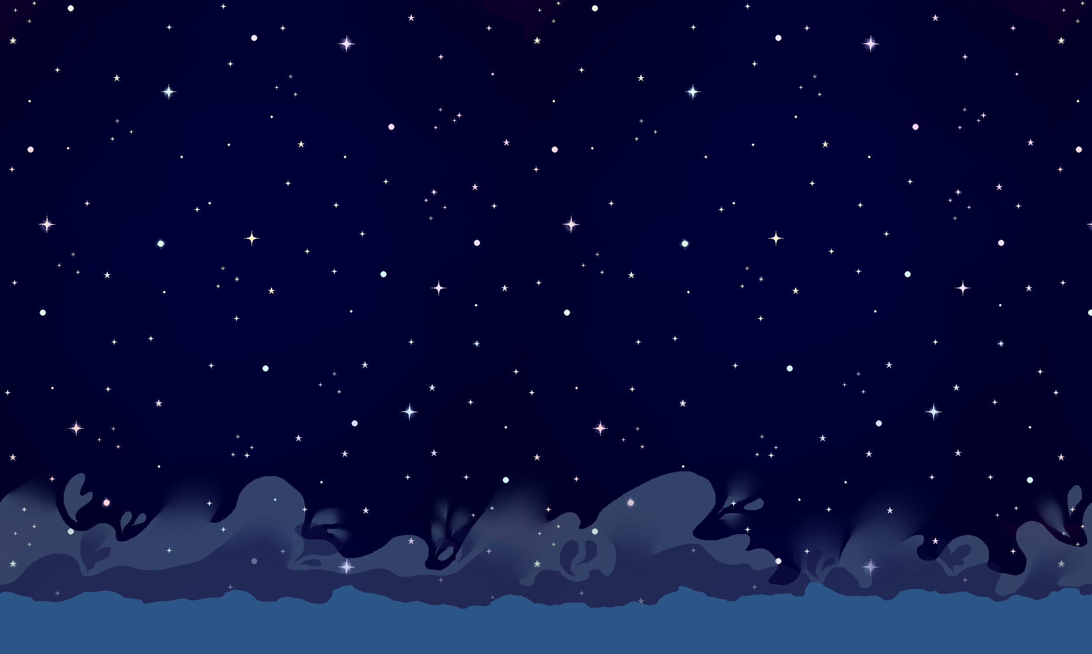


Slide 11
Gage Stevens - Programmer

Slide 12
Contributions
Player and enemy health handling
Enemy movement
Overworld character movement
Boss fight AI

Slide 13
Dave Ho - Programmer

Slide 14
Contributions
Side scrolling Character Movement Scripts
Bullet Scripts
Shield Scripts
Crystals that allow player into Dyson sphere
Physics within the game
Level Design

Slide 15
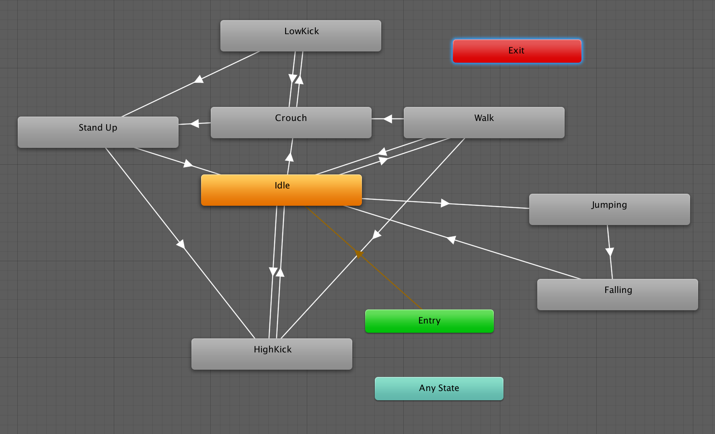
Animation

Slide 16
Michael Einhorn (Sound Designer)

Slide 19
Thank You

